Slide 1

Contact Management SysteM
Team members:
2310030447 Deepthi 2310030070 Yashitha
2310030155 Jayathi 2310030400 Aneeshwa

Slide 2
Introduction
The Contact Management System is a project designed to simplify the organization and management of contact information.
It provides core functionalities such as adding, viewing, updating, and deleting contact details
The system is built using Java and uses basic data structures to handle contact data, providing an easy-to-use and practical solution for everyday contact management needs.

Slide 3
Key Features and Requirements
1. Create Contact
Allows users to add new contacts with various attributes, including name, phone number, email.
The user provides the contact's name, phone number, and email address.
The system checks if the name already exists to avoid duplicates.
If the contact doesn’t exist, it is added to the collection.
2. Read/Retrieve Contact
Provides options for searching, filtering, and sorting contacts based on criteria.
Details:
For single contact view, if the name doesn’t exist, show an appropriate message.
.

Slide 4
Update Contact
Description: Modify the details of an existing contact.
Details:
The user can update the phone number, email, or both for an existing contact.
The system first checks if the contact exists. If not, it displays an error message.
Validation:
Similar checks for phone and email as during the creation process.
Delete Contact
Description: Remove a contact from the system.
Details:
The user specifies the name of the contact to delete.
If the name exists, the contact is removed from the collection.
If not, the system displays an appropriate error message.

Slide 5
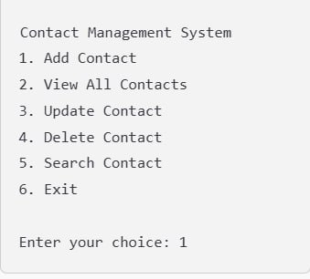
Search Contacts
Description: Allows the user to search for contacts by their name.
Details:
Search for partial or complete matches of the name.
Return a list of contacts matching the search term.
Sample Output:

Slide 6
WORKING
User Interface (UI):
The system provides a GUI (desktop or web-based) for users to interact with.
Input Handling:
Users input data like name, phone number, email, and address via forms.
The input is validated to ensure data consistency.
Processing Logic:
CRUD operations (Create, Read, Update, Delete) are handled here.
Database Interaction:
The data is stored and retrieved from a relational database like MySQL
Search and Filter:
The system allows users to search for contacts based on criteria like name phone number.
Sorting and filtering options enhance usability.

Slide 7

software requirements
Operating System: Windows, macOS, or Linux
Java Development Kit (JDK): Version 8 or higher
Integrated Development Environment (IDE): Eclipse IDE for Java Developers, with JDK 8
Database: MySQL

Slide 8

OTHER TECHNICAL COMPONENTS
Collections
store, retrieve, update, and delete contact information, which involves:
Efficient Data Retrieval
Dynamic Storage.
Flexibility
HashMap
Used to store contacts, where the key is the unique identifier (e.g., name or ID)
and the value is the object
ArrayList
Displaying contacts in a specific order.
Performing operations on a list of all contacts.

Slide 9

Thank you

